Slide 1

CSE 583
Software Design for Data Scientists Command line essentials
David Beck^{1,2,3}
Anant Mittal³
¹eScience Institute
²Chemical Engineering
³Computer Science
University of Washington
October 05, 2021

Slide 2


File system basics
File – container of data
Directory – container of files and directories
Directories are organized into a tree
Directory (AKA dir)
Sub-directory
Data
README
File
pronto.csv
File

Slide 3
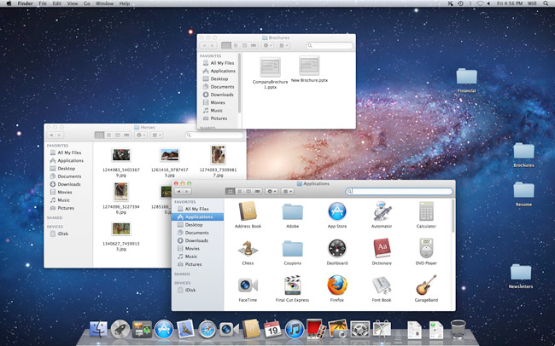
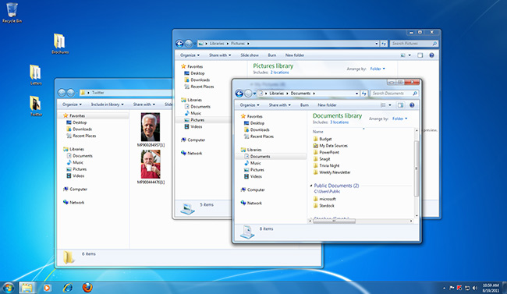
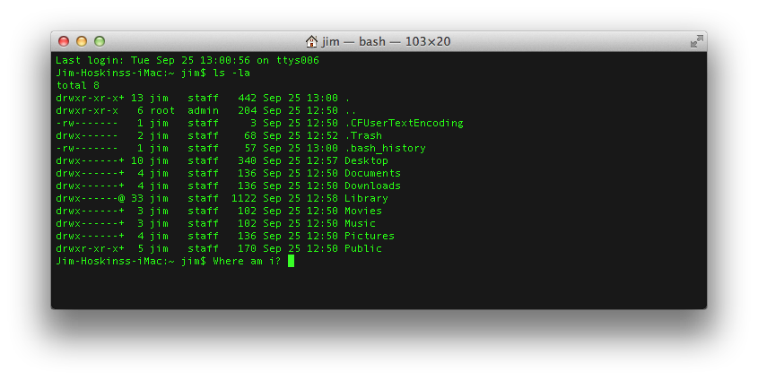
GUI vs. Command line
Graphical User Interface (GUI)
Command Line Interface (CLI)

Slide 4
Why pointy clicky bad
How do you preserve a record of your actions?
Using the command line you get history
You can collect your commands into a ‘script’ that can be reused to exactly duplicate your procedure

Slide 5
Command line tools
What is the command line?
Also known as a ‘shell’
Most common shell is bash (what we will use)
Bourne Again Shell
Reimplementation of a shell from 1977
Every OS/X Mac
Every Linux box in the world
Every supercomputer
’Programming’ language itself
‘scripting’ language
Ken Thompson

Slide 6
Command line tools
Where is the command line?
Mac (pre-installed)
Applications -> Utilities -> Terminal
Windows (after install Git / Bash)
Start -> Git -> Git Bash
Give it a go! Open a shell window.

Slide 7
Command line tools
Commands take ‘arguments’
Stuff after the command name
Arguments alter the function of the command
E.g. specify what file to use as input or output
Many commands accept the special argument to return help, usually one of
--help
-help
-h
-omghelpmeImlost

Slide 8
Command line tips and tricks
Tab completion is your friend
When entering a file arguments
When entering directory pathes
Hitting tab will autocomplete the filename!
I will pester you about this

Slide 9
Commands for files & dirs
By category
Create
Directory: mkdir
File: various (e.g., cp, touch)
View contents
Directory: ls
File: cat
Remove
Directory: rmdir
File: rm

Slide 10
Quick review from Tue
What do the following commands do?
ls
mkdir
cp
rm
touch
cat
rmdir
cat
more / less

Slide 11
Web from the command line?
Can we interact with the web from the CLI?
YES!
curl
Stands for “Copy URL”
URL = uniform resource locator
E.g. http://, https://, file://, ftp://, …
Let’s play with curl!

Slide 12
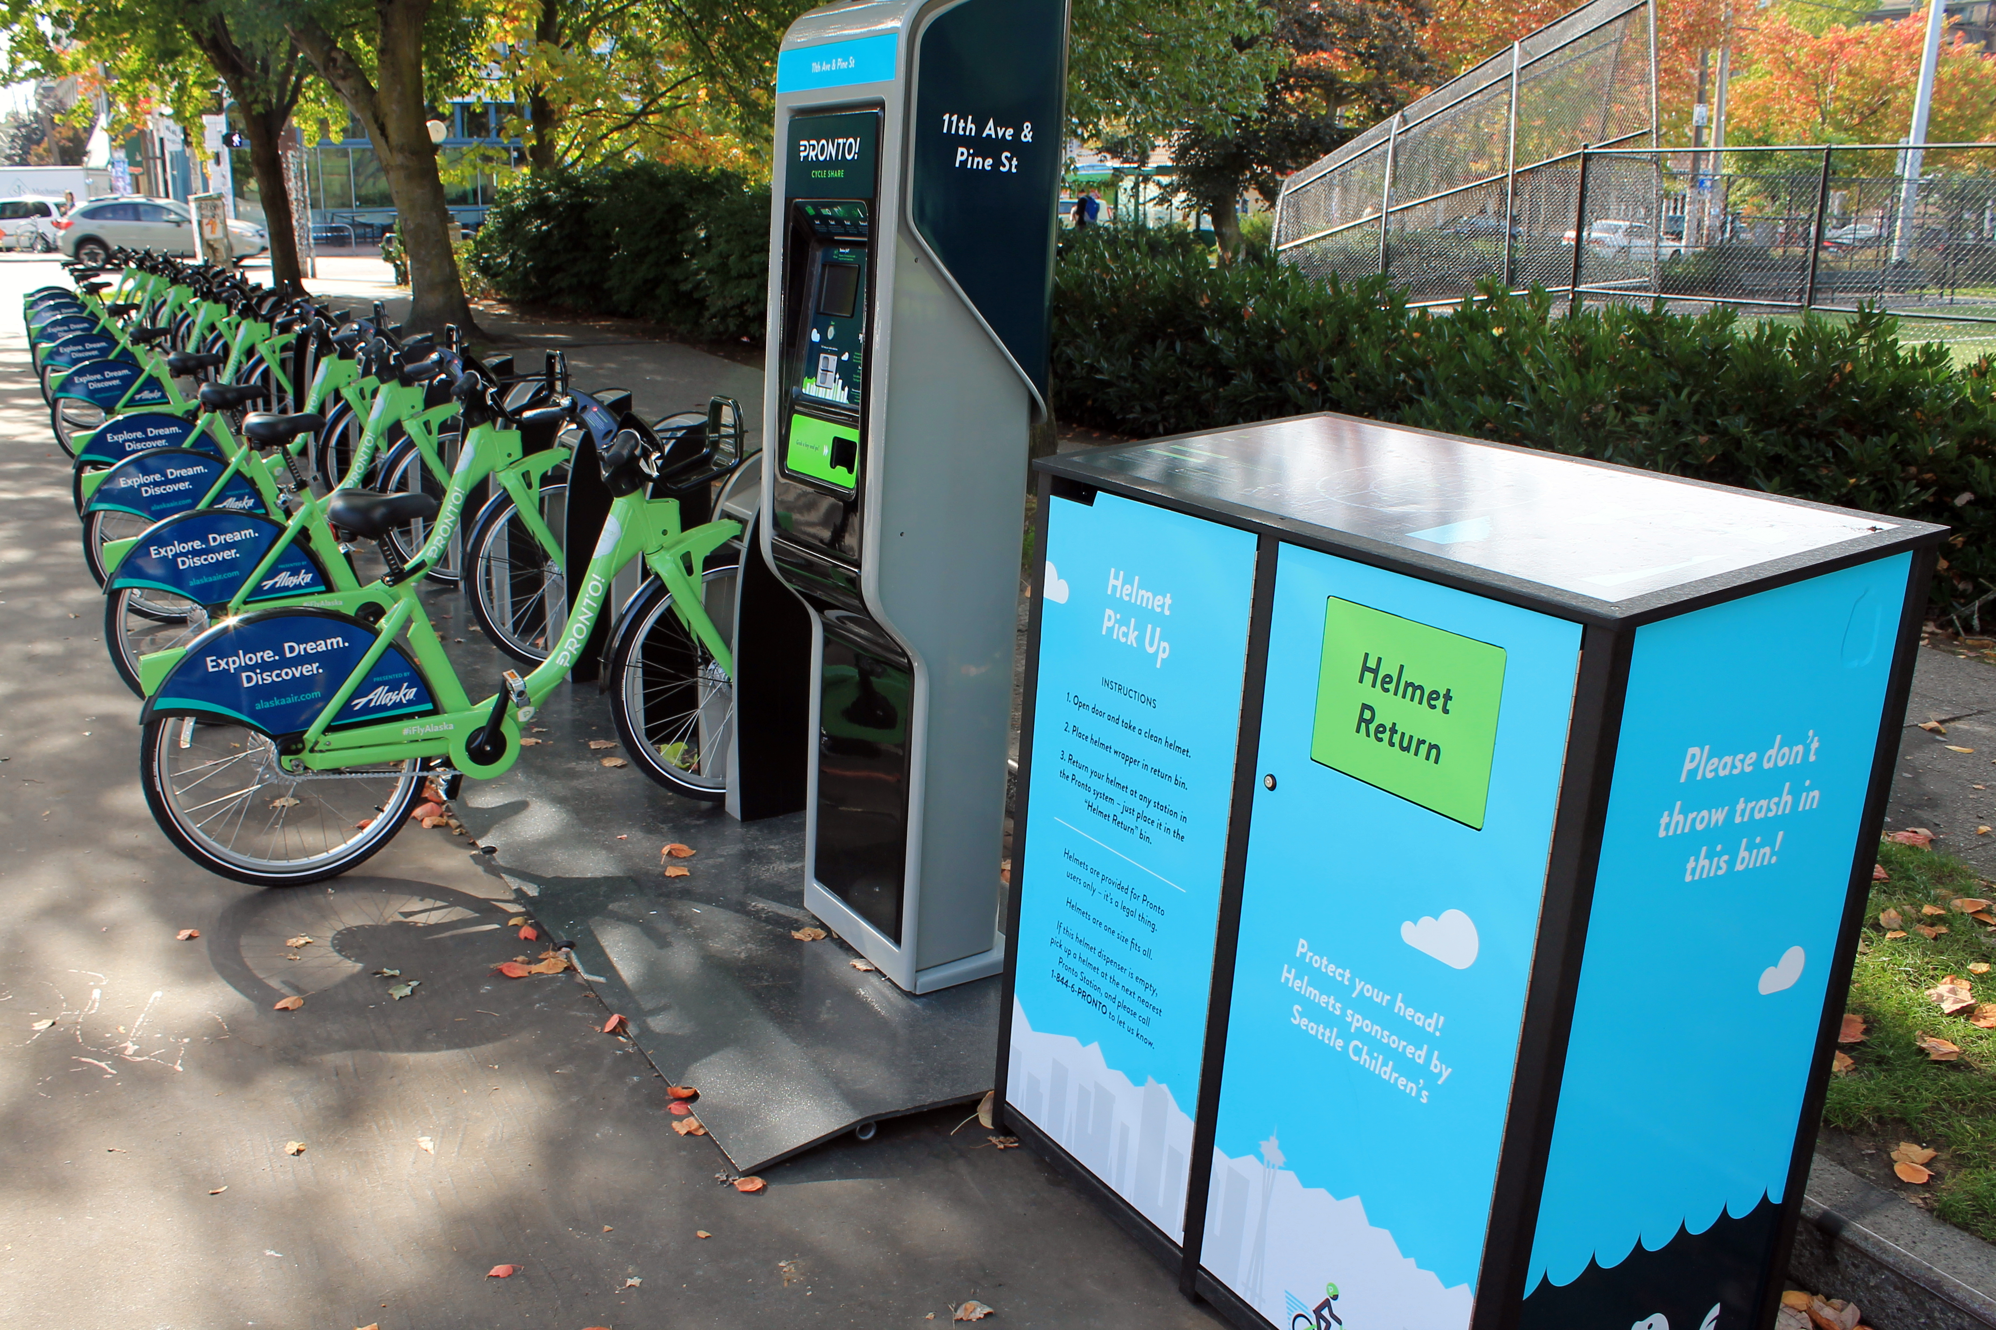
Pronto Data
12

Slide 13
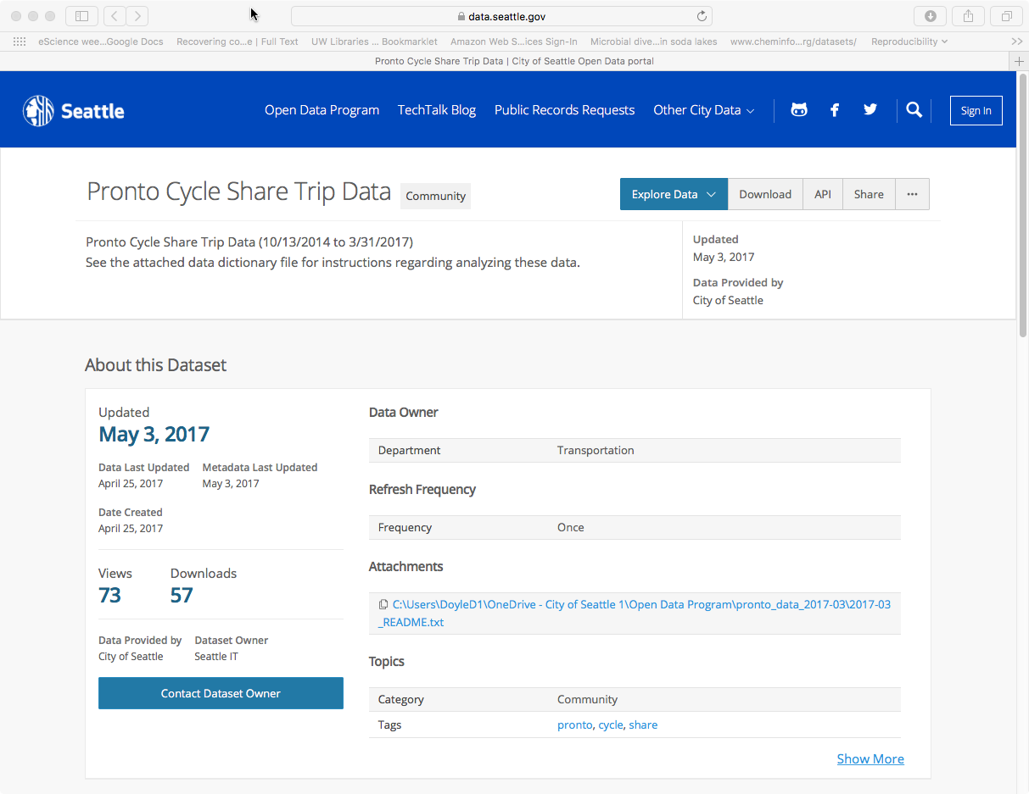
https://data.seattle.gov/Community/Pronto-Cycle-Share-Trip-Data/tw7j-dfaw

Slide 14
Fields in Pronto Data
Variable | Data Type | Units
trip_id | Int64
starttime | datetime64
stoptime | datetime64
bikeid | string | Coded (e.g., "SEA00298")
tripduration | float | Seconds
from_station_name | string | Address
to_station_name | string | Address
from_station_id | string | Coded (e.g., "PS-04")
to_station_id | string | Coded (e.g., "PS-04")
usertype | string | Coded (e.g., "Annual Member")
gender | string | Coded (e.g., "Male")

Slide 15
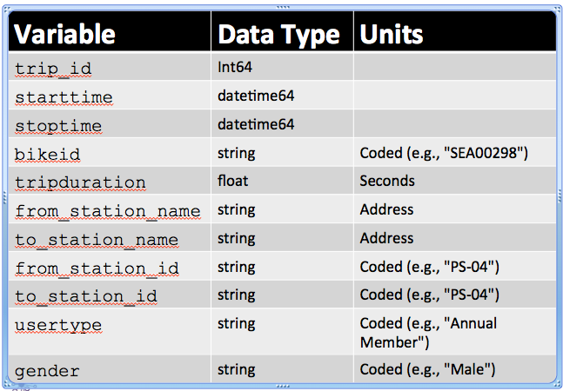
Data Considerations
Do similar fields have the same data type and/or code (e.g., from_station_id, to_station_id)?
Do coded data have useful information hidden in the codes (e.g., "PS-04")?
How merge with other data (e.g., weather)?

Slide 16
Data Schema
"Meta data" – describes the data
data types
units
"keys" (how relate one data set to another)

Slide 17
Getting Data With Shell Scripts
17

Slide 18
Commands for Files & Directories
By category
Create
Directory: mkdir
File: various (e.g., cp)
View contents
Directory: ls
File: cat
Remove
Directory: rmdir
File: rm
Data
README
Pronto

Slide 19
Demo
Create the project directory structure and README
Get the pronto data from the Internet, https://data.seattle.gov/api/views/tw7j-dfaw/rows.csv?accessType=DOWNLOAD
Unpack the data
Comma separated variable (CSV) files
Automate the workflow using a shell script

Slide 20
Useful Shell Commands
Command | Task | Example usage
ls | List files | ls
cp | Copy files | cp original_file new_file
mv | Move / rename files | mv original_file new_file
rm | Remove / delete files | rm original_file
cd | Change directory | cd some_directory
pwd | Print working / current directory | pwd
mkdir | Create directory | mkdir some_directory
rmdir | Remove / delete directory | rmdir some_directory
cat | View files | cat some_file
head | View begining of file | head some_file
tail | View end of file | tail some_file
grep | Search file for matching lines | grep search.text some_file
sort | Sort lines | sort some_file
uniq | Print unique lines | uniq some_file
diff | Compare to files | diff original_file new_file
unzip | Uncompress a file | unzip compressed_file.zip
curl | Download a file using its URL | curl some URL
Also see http://www.pixelbeat.org/cmdline.html
Also search shell + <cmd name>

